Slide 1
Hate Posters
Meeting at Scottish Parliament
5 December 2018
Dr Martin Parsons
Head of Research Barnabas Fund International Headquarters

Slide 2
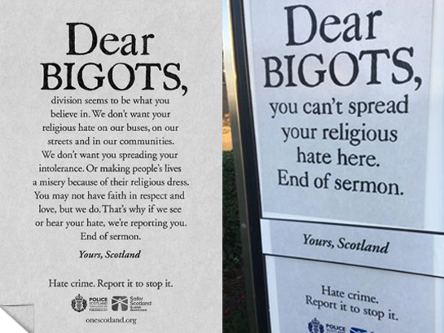

Slide 3
Messages on hate posters
 | Implied victim | Implied aggressor
Dear BIGOTS (longer version) | Those wearing religious dress (Muslim, Sikh, Jewish?) | Members of other groups – but ‘End of sermon’ implies Christians
Dear BIGOTS (shorter version) | Non religious people | Religious people, with a specific implication of Christians
Dear disabalists | disabled people | Non disabled people
Dear homophobes | Lesbian and gay people | Non LGB people
Dear racists | Members of racial minorities | Members of other racial groups
Dear transphobes | transgender people | Non transgender people

Slide 4
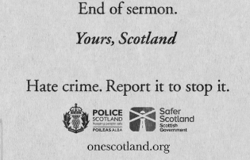
State sponsored actions
Logos of Police Scotland and Safer Scotland
State sponsored actions are far more serious than prejudice exhibited by individuals
May breach international human rights standards (International Covenant on Civil and Political Rights)

Slide 5
International Covenant on Civil and Political Rights (ICCPR)
UK and all EU countries are legally bound signatories to
Article 18 everyone has the right in public or private to manifest his religion in worship, observance, practice and teaching
Article 19 Everyone shall have the right to freedom of expression; this right shall include freedom to seek, receive and impart information and ideas of all kinds, regardless of frontiers, either orally, in writing or in print, in the form of art, or through any other media of his choice.
Articles 18 and 19 may only be limited to respect of the rights or reputations of others, national security, public order, public health or morals.
Article 20 prohibits governments from engaging in advocacy which may constitute incitement to either i) hostility ii) discrimination or iii) violence on grounds of religion.

Slide 6
DEVELOPMENT OF FREEDOM OF RELGION

Slide 7
WHY STATE SPONSORED PREJUDICE MATTERS (1)
Freedom of religion can be reversed

Slide 8
FREEDOM OF RELIGION CAN BE REVERSED
1592 GREAT CHARTER OF THE CHURCH OF SCOTLAND (General Assembly Act)
- freedom to interpret the Bible without state interference
- freedom from state interference in church appointments

Slide 9
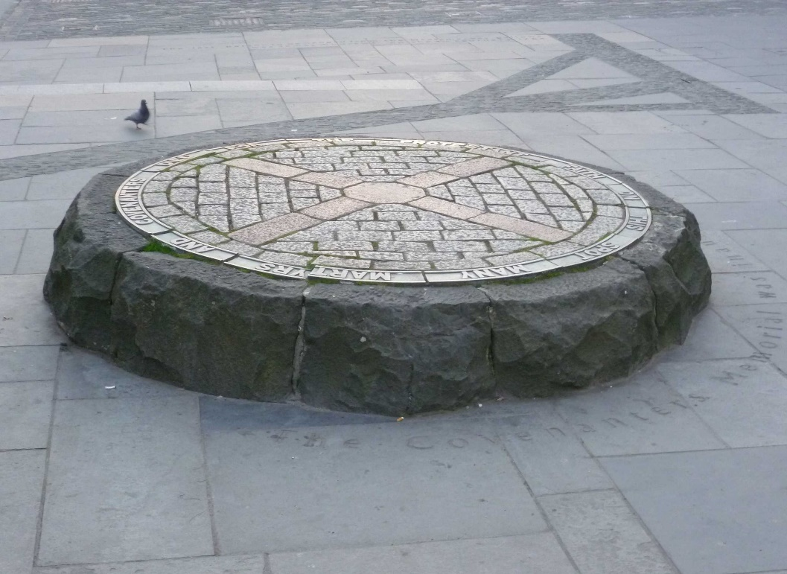
1661 Acts of Scottish parliament
- High treason to form an association without king’s special permission (meet to preach or worship outside established church)
- Test Act excluded from church, civil and military office with further punishment
All who by writing, printing, praying, preaching, or declare any words or sentences to stir up the people to hatred and dislike of his majesty’s royal prerogative and supremacy in causes ecclesiastical or of the government of the church by archbishops and bishop
Covenanter struggle
The killing time

Slide 10
WHY STATE SPONSORED PREJUDICE MATTERS (2)
State sponsored actions
Actions by individuals
State sponsored prejudice… encourages and empowers…
prejudice, discrimination and violence by individuals

